Slide 1
跟課成果報告：TA Guideline
EMI必修課TA，須於期末(6/28 周日前)上傳當學期跟課過程中，所觀察到學生對於EMI課程學習的狀況進行回饋。
依所提供之簡報範本撰寫，上傳PDF 檔，且合計檔案大小合計不得超過10MB。
注意：報告若引用素材應符合智慧財產權相關規定，如有違反，相關法律責任由TA自行負責，該簡報之著作財產權仍屬原作者所有，雙語辦公室得以任何形式及方式，無償公開於本校相關網站供師生瀏覽。 上傳時請刪除此頁

Slide 2
TA Guideline
EMI Mandatory Course TAs are required to submit a feedback report by the end of the semester (no later than June 28) based on their observations of students' learning performance in the EMI course throughout the term.
The report must be written following the presentation template, submitted in PDF format, and the total file size must not exceed 10MB.
Important Notes :
If external materials are cited in the report, all content must comply with intellectual property regulations. The TA shall bear full legal responsibility for any violations. The copyright of the presentation remains with the original author. However, beer.c reserves the right to freely publish the submitted files on the NCKU-related websites for public access.
Please delete this page when uploading

Slide 3

114-2 TA Guideline
TA Name：
Class：

Slide 4
1. Common Student Difficulties During the Course
Mark the common challenges students face during course instruction or when applying the course material.
Challenge Type | mark | Challenge Type | mark | Challenge Type | mark
Time Management Issues Description : |  | Lack of Motivation & Focus Description : |  | Heavy Workload & Academic Pressure Description :
Group Work & Collaboration Issues Description : |  | Difficulty Understanding Course Material Description : |  | Adapting to Different Teaching & Learning Styles Description :
Poor Study Skills & Exam Preparation Description : |  | Financial Stress Impacting Academics Description : |  | Language Barriers Description :
Mental Health Challenges Description : |  | Other： Description :

Slide 5

2. TA’s Challenges During the Course and Possible Solutions Used
Write the difficulties you faced as an EMI TA and the strategies or solutions you implemented to address them.
1.
2.
3

Slide 6
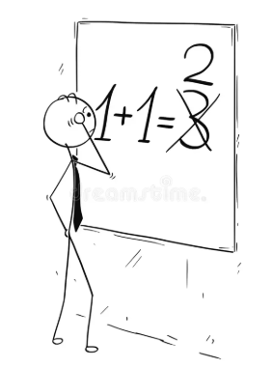
3. TA’s Mistakes and Possible Corrections
• Detail any errors you made as TA during the EMI course
----------------------------------------------------------------------------------------------------------------------------------------------------------------------------------------------
Describe the steps taken to correct these mistakes
--------------------------------------------------------------------------------------------------------------------------------------------
----------------------------------------------------------------------

